Slide 1
Backend development with expressjs
i4GIC

Slide 2
What is expressjs ?
Express is a minimal and flexible Node.js web application framework that provides a robust set of features for web and mobile applications.
Alternative to ExpressJs, there are plenty more of nodejs framework:
Koa.js
Meteor
Sokcket.io
Nest.js
Sails.js
Total.js
Hapi.js
Feather.js
Loopback.js
Adonis.js
Derby.js
……

Slide 3
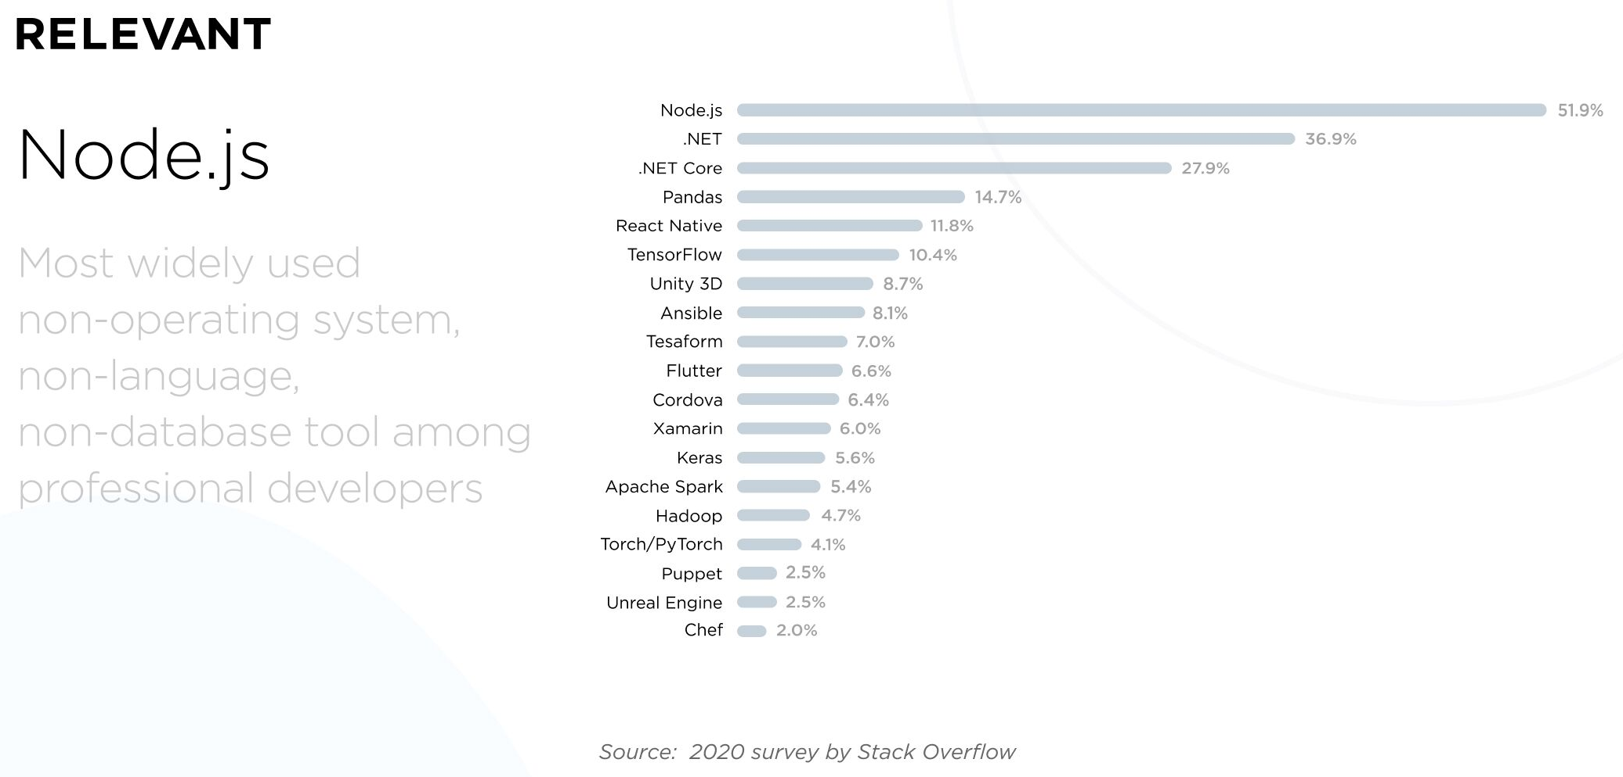
What is nodejs?
Node.js is a cross-platform runtime environment, built on V8, high-performance open-source JavaScript engine. To ensure outstanding performance, Node.js applies event-driven, non-blocking I/O paradigm.
Node.js is best suitable for:
Real-time web applications
Streaming applications
Messaging apps
Social media apps
Multiplayer games
API
Collaboration tools

Slide 4
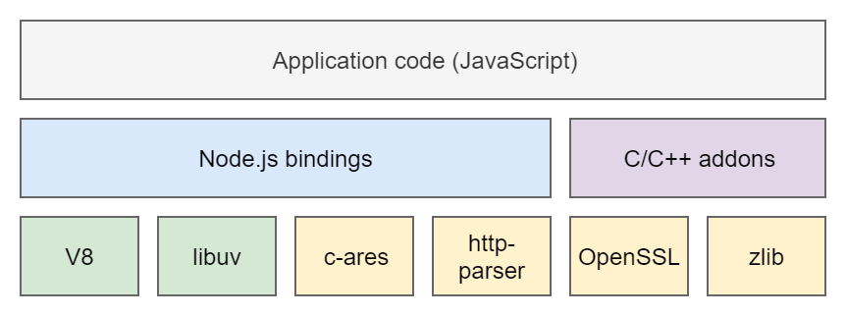
Node.js components
Source: https://itnext.io/an-intro-to-node-js-that-you-may-have-missed-b175ef4277f7

Slide 5
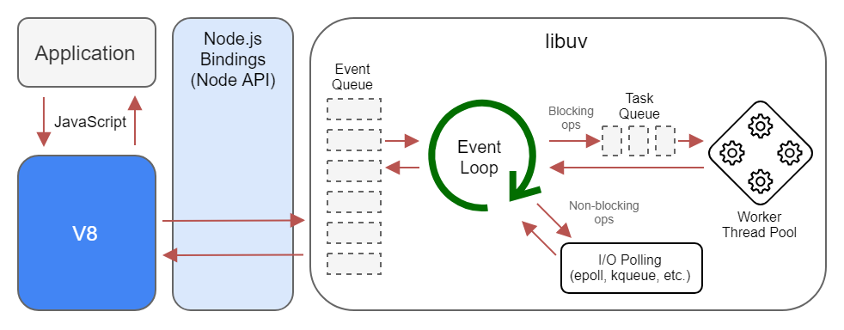
Node.js runtime diagram

Slide 6
Blocking the event loop
Any JavaScript code that takes too long to return back control to the event loop will block the execution of any JavaScript code in the page, even block the UI thread, and the user cannot click around, scroll the page, and so on.
Almost all the I/O primitives in JavaScript are non-blocking. Network requests, filesystem operations, and so on. Being blocking is the exception, and this is why JavaScript is based so much on callbacks, and more recently on promises and async/await.

Slide 7
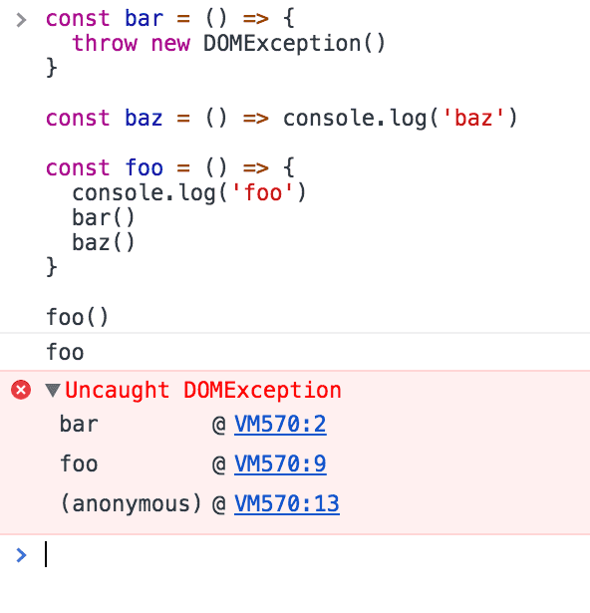
The call stack
The call stack is a LIFO (Last In, First Out) stack.
The event loop continuously checks the call stack to see if there's any function that needs to run.
While doing so, it adds any function call it finds to the call stack and executes each one in order.

Slide 8
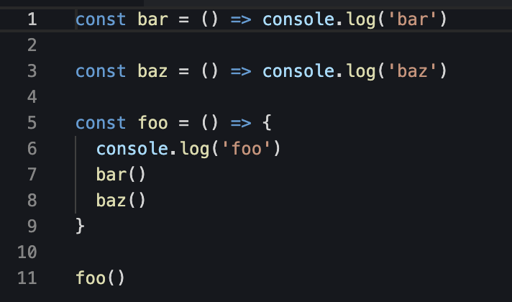
A simple event loop explanation
When this code runs, first foo() is called. Inside foo() we first call bar(), then we call baz()

Slide 9
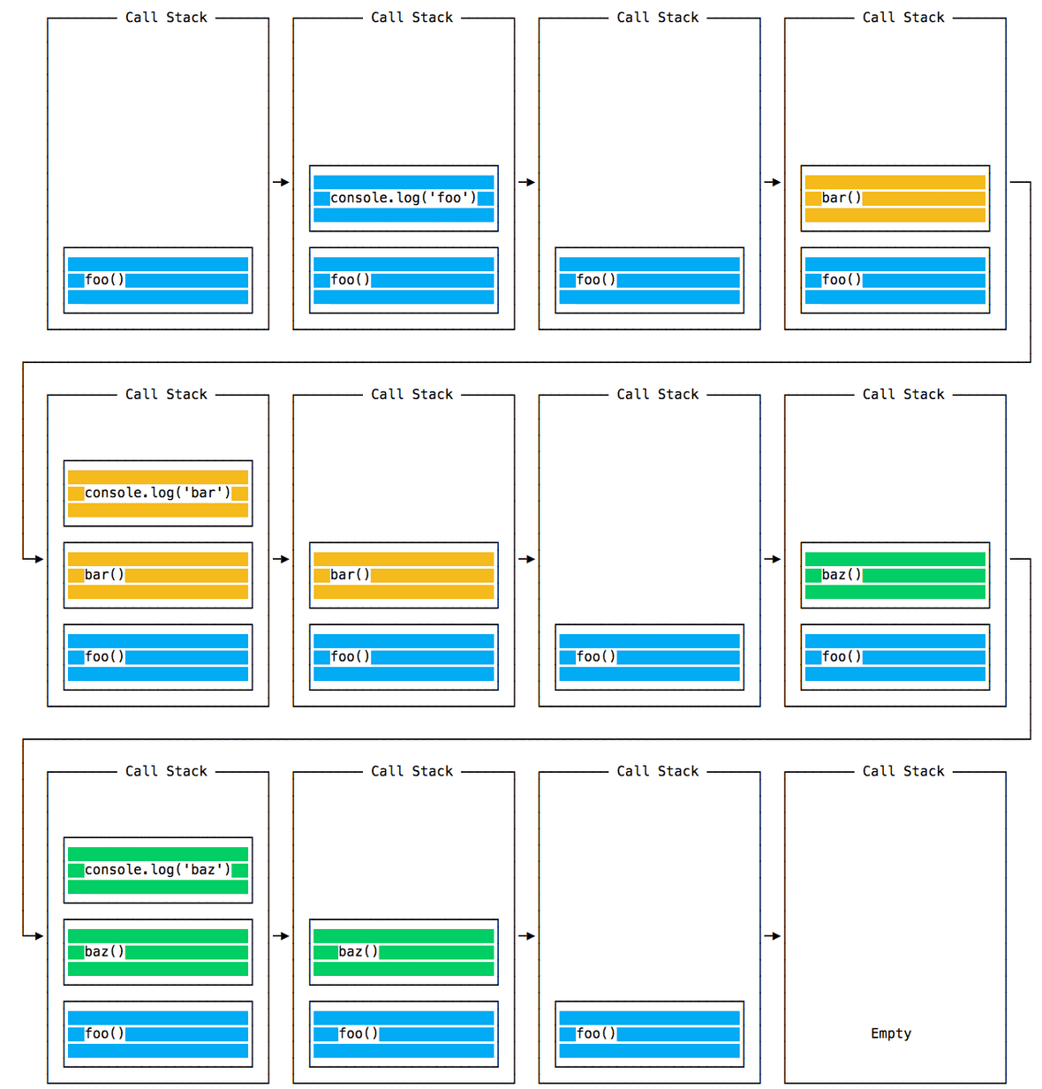
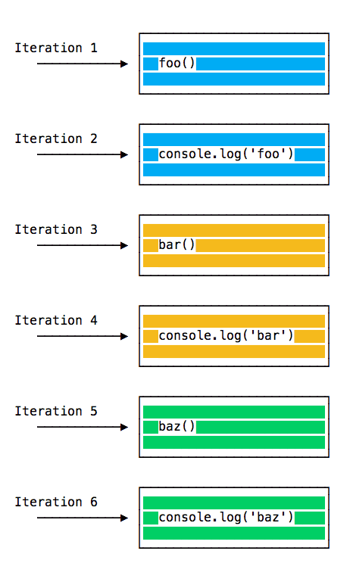

Slide 10
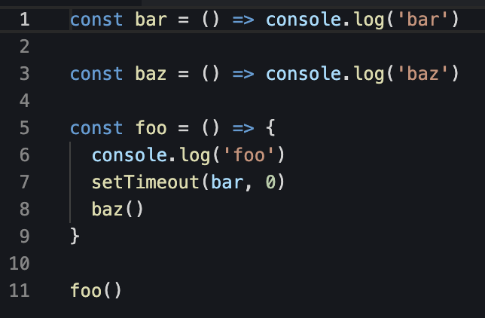
Another example
When this code runs, first foo() is called. Inside foo() we first call setTimeout, passing bar as an argument, and we instruct it to run immediately as fast as it can, passing 0 as the timer. Then we call baz().

Slide 11
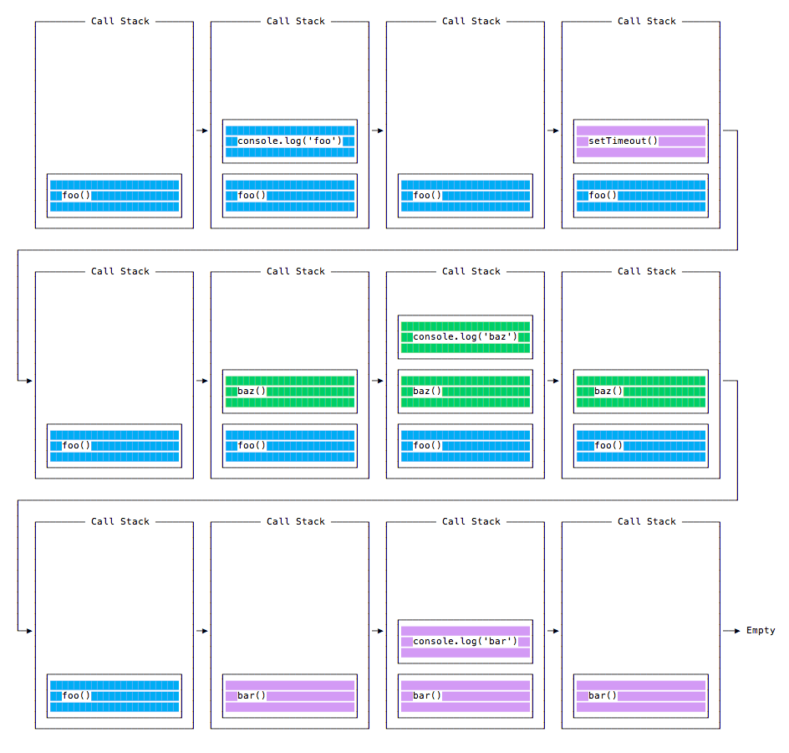
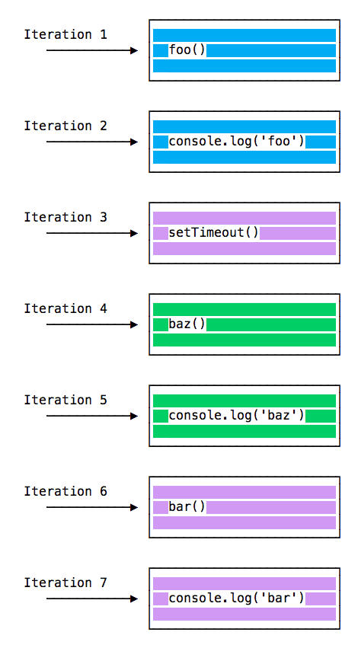

Slide 12
The message queue
When setTimeout() is called, the Browser or Node.js starts the timer. Once the timer expires, in this case immediately as we put 0 as the timeout, the callback function is put in the Message Queue.
The Message Queue is also where user-initiated events like click or keyboard events, or fetch responses are queued before your code has the opportunity to react to them. Or also DOM events like onload
The loop gives priority to the call stack, and it first processes everything it finds in the call stack, and once there's nothing in there, it goes to pick up things in the message queue.
We don't have to wait for functions like setTimeout, fetch or other things to do their own work, because they are provided by the browser, and they live on their own threads.

Slide 13
ES6 Job Queue
ECMAScript 2015 introduced the concept of the Job Queue, which is used by Promises (also introduced in ES6/ES2015). It's a way to execute the result of an async function as soon as possible, rather than being put at the end of the call stack.
Similar to a rollercoaster ride at an amusement park: the message queue puts you at the back of the queue, behind all the other people, where you will have to wait for your turn, while the job queue is the fastpass ticket that lets you take another ride right after you finished the previous one.

Slide 14
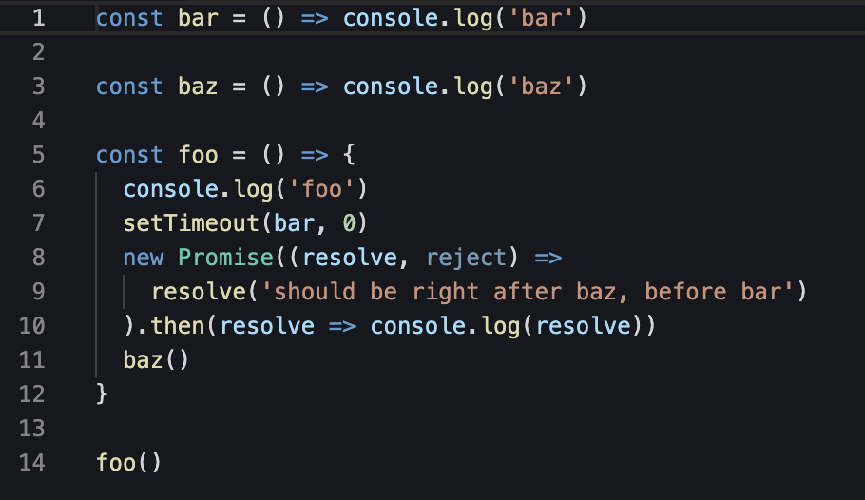

Slide 15
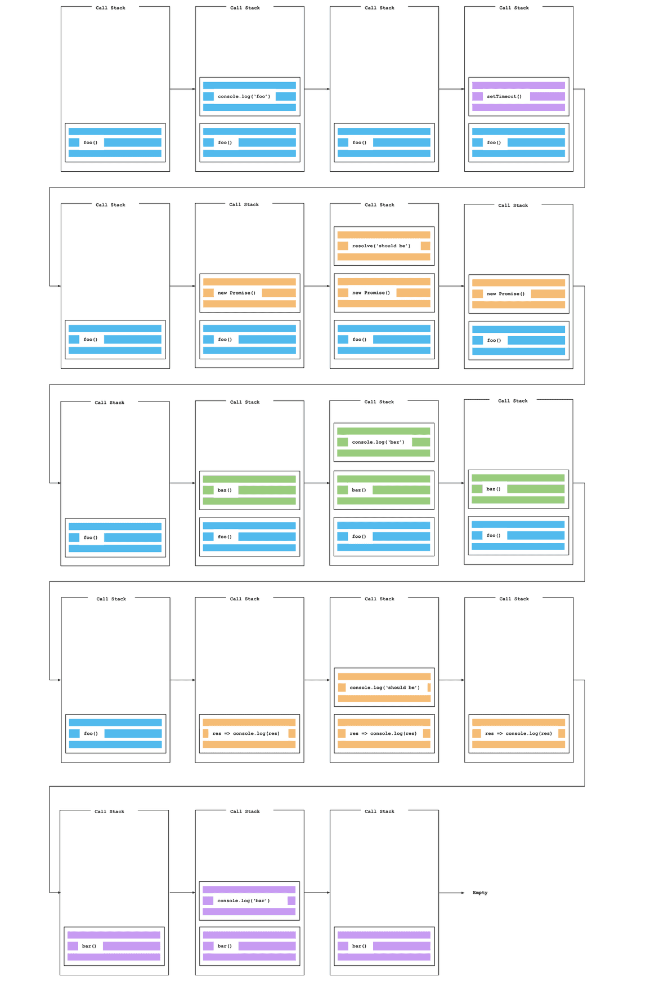

Slide 16
preparation
Make sure you have the following ready:
NodeJs : Runtime environment for javascript
NPM : Node Packaage Manager to install dependencies
Nodemon : Live server, hot reload.
You may set up the nodejs project
npm init : create empty nodejs project
npm install --save express : Install expressjs as dependency

Slide 17
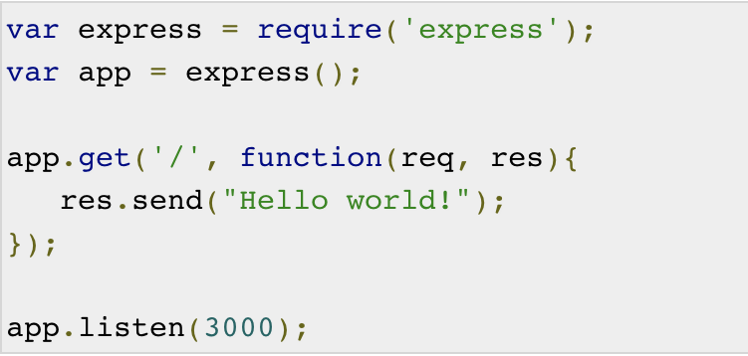
Example

Slide 18
